Slide 1



DUAL-INTERFACE HOSPITAL MANAGEMENT SYSTEM

Slide 2
GROUP MEMBERS
• Anusree S S
• Adithya M Ashokan
• Asna M Nassar
• Aseef Muhammed
• Aswin T S

Slide 3
CONTENTS
Introduction
ER Diagram
Literature review
Methodology
Problem statement
Conclusion
Proposed solution
Reference

Slide 4
INTRODUCTION
Modern healthcare demands efficient, secure, and user-friendly digital solutions. The MediBridge Dual-Interface Hospital Management System addresses this need by offering a modular application tailored for both hospital staff and patients. With its role-based login structure, the system ensures that doctors, nurses, administrators, and patients access only the features relevant to their roles. This not only improves operational workflow and data security but also enhances the overall patient experience. MediBridge serves as a bridge between medical professionals and patients, enabling seamless management of medical records, appointments, billing, and more—all within a single integrated platform.

Slide 5
LITERATURE REVIEW
• Hospital Management Systems (HMS) aim to
digitalize hospital operations, improving
efficiency and accuracy in patient care,
appointments, billing, and record keeping.
• Existing solutions like Practo, Medixcel EMR,
and MediSteer offer various features but
often lack real-time OP token tracking,
operation progress updates for bystanders,
and integrated emergency contact options.

Slide 6
PROBLEM STATEMENT
Inefficient Manual Processes :
Hospitals struggle with outdated,paper-based
systems leading to delays and errors.
2.Lack of Role-Based Access :
Absence of customized interfaces for staff and patients
causes confusion and data overload.
3. Poor Communication and Transparency :
Patients and bystanders often lack timely updates on appointments, treatments and reports.
4. Need for Integrated Solution :
There is a growing demand for a secure, modular system
that streamlines operations and improve user
experience.

Slide 7
PROPOSED SOLUTION
The dual interface hospital management system includes:
Patient Interface: View medical records, book appointments, receive prescriptions
Staff Interface: Manage schedules, update inventory, issue prescriptions, maintain records
Key Features:
Login authentication for all users
Doctor availability tracking
Integrated pharmacy and inventory
Role-based access and data confidentiality
Mobile & web-friendly design

Slide 8
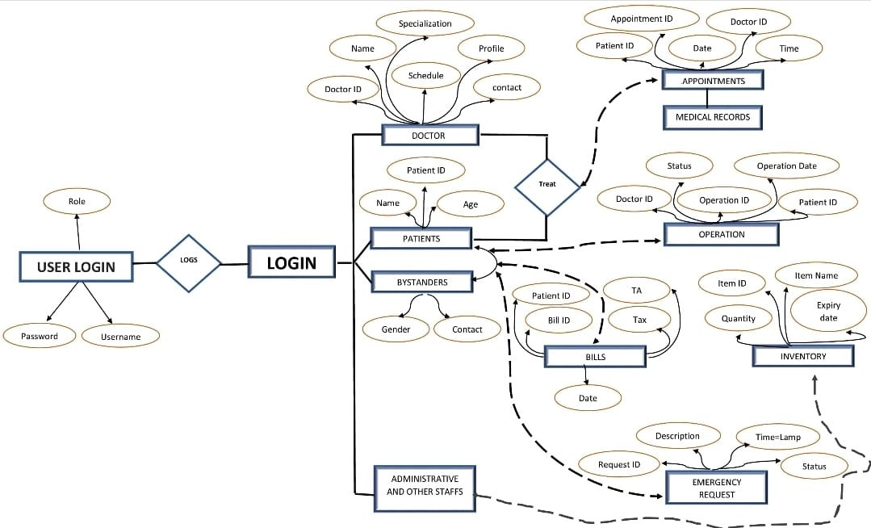
ER DIAGRAM

Slide 9
METHODOLOGY
RequiremnetsGathering
System Design
-Interviews and discussions were simulated to identify core functional needs of:
- Hospital staff (doctors, nurses, admin)
- Patients and their bystanders
- Key priorities included: usability, security, real-time access, appointment management, and
medical record digitization.
-Use Case Diagrams and Entity-Relationship Models (ERD) were created to visualize workflows.
- Role-based access control was mapped out:
- Admins, doctors, nurses, lab technicians (Staff Interface)
- Patients and family members (Patient Interface)
- Database schema was designed for efficient medical data handling and relational integrity.

Slide 10
Architecture Selection
Technology Stack
-Adopted a 3-layered architecture:
- UI Layer: Developed using Java Swing/JavaFX for responsive graphical user interfaces.
- Service Layer: Manages business logic, validations, and workflow coordination.
- DAO Layer: Handles all interactions with the database using JDBC.
-Frontend: Java Swing/JavaFX
- Backend: Java (OOP-based)
- Database: MySQL / SQLite
- Connectivity: JDBC
- Security: Encrypted logins, session management, role-based permissions

Slide 11
Implementation
Testing
-Modules were developed incrementally with unit testing:
- Staff Interface: Medical records, appointments, billing, inventory, reports
- Patient Interface: Registration, appointment booking, OPD token tracking, discharge summaries
- Real-time status updates (e.g., surgery progress, OPD queue) were simulated using dynamic UI
refresh and backend triggers.
-Conducted functional, integration, and usability testing for both user types:
- Test cases included appointment flow, billing accuracy, login validation, record retrieval, etc

Slide 12
CONCLUSION
The proposed system is a comprehensive approach to digital hospital management.
By offering dual interfaces, it ensures seamless communication and coordination.
It enhances user experience, reduces administrative overhead, and improves operational efficiency.
Future Scope:
Integration with wearable health devices
AI-based diagnosis support
SMS/Email alerts for patients

Slide 13
REFERENCE
Sharma, R. (2021). Modern Hospital Systems. HealthTech Journals.
2. WHO Guidelines for Digital Health Records (2023).
3. ISRO HealthNet Documentation. (2022).

Slide 14
Thank You

